Slide 1

WQD 7003 Data Analytics
CHAPTER 3 – DATA PREPROCESSING
Saw Shier Nee, Hema Subramaniam & Aznul Qalid Md Sabri
sawsn@um.edu.my , hema@um.edu.my, aznulqalid@um.edu.my
Dept. of AI, Fac. of Computer Scaience and IT, University of Malaya
Dept. of SE, Fac. of Computer Science and IT, Universiti Malaya

Slide 2

Outline
Why preprocess the data?
Descriptive data summarization
Data cleaning
Data integration and transformation
Data reduction
Discretization and concept hierarchy generation
Summary

Slide 3
Learning Outcomes
At the end of this lecture, student will be able to:
To explore the appropriate technique for data pre-processing

Slide 4
Why Data Preprocessing?
Data in the real world is dirty
incomplete: lacking attribute values, lacking certain attributes of interest, or containing only aggregate data
e.g., occupation=“ ”
noisy: containing errors or outliers
e.g., Salary=“-10”
inconsistent: containing discrepancies in codes or names
e.g., Age=“42” Birthday=“03/07/1997”
e.g., Was rating “1,2,3”, now rating “A, B, C”
e.g., discrepancy between duplicate records

Slide 5
Why is Data Dirty?
Incomplete data may come from
“Not applicable” data value when collected
Different considerations between the time when the data was collected and when it is analyzed.
Human/hardware/software problems
Noisy data (incorrect values) may come from
Faulty data collection instruments
Human or computer error at data entry
Errors in data transmission
Inconsistent data may come from
Different data sources
Functional dependency violation (e.g., modify some linked data)
Duplicate records also need data cleaning

Slide 6
Why is Data Preprocessing Important?
No quality data, no quality mining results!
Quality decisions must be based on quality data
e.g., duplicate or missing data may cause incorrect or even misleading statistics.
Data warehouse needs consistent integration of quality data
Data extraction, cleaning, and transformation comprises the majority of the work of building a data warehouse

Slide 7
Multi-Dimensional Measure of Data Quality
A well-accepted multidimensional view:
Accuracy
Completeness
Consistency
Timeliness
Believability
Value added
Interpretability
Accessibility
Broad categories:
Intrinsic, contextual, representational, and accessibility

Slide 8
Major Tasks in Data Preprocessing
Data cleaning
Fill in missing values, smooth noisy data, identify or remove outliers, and resolve inconsistencies
Data integration
Integration of multiple databases, data cubes, or files
Data transformation
Normalization and aggregation
Data reduction
Obtains reduced representation in volume but produces the same or similar analytical results
Data discretization
Part of data reduction but with particular importance, especially for numerical data

Slide 9
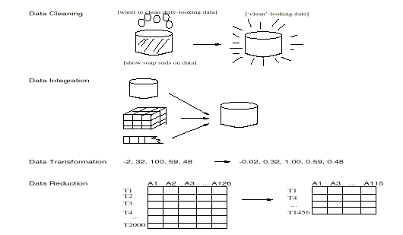
Forms of Data Preprocessing

Slide 10
Outline
Why preprocess the data?
Descriptive data summarization
Data cleaning
Data integration and transformation
Data reduction
Discretization and concept hierarchy generation
Summary

Slide 11
Mining Data Descriptive Characteristics
Motivation
To better understand the data: central tendency, variation and spread
Data dispersion characteristics
median, max, min, quantiles, outliers, variance, etc.
Numerical dimensions correspond to sorted intervals
Data dispersion: analyzed with multiple granularities of precision
Boxplot or quantile analysis on sorted intervals
Dispersion analysis on computed measures
Folding measures into numerical dimensions
Boxplot or quantile analysis on the transformed cube

Slide 12
Measures of Central Tendency
Measures of the location of the middle or the center of a distribution
Mean, median, mode

Slide 13
Measures of Central Tendency - Mean
Mean – Most commonly used measure of central tendency
Average of all observations
The sum of all the scores divided by the number of scores
Note: Assuming that each observation is equally significant

Slide 14
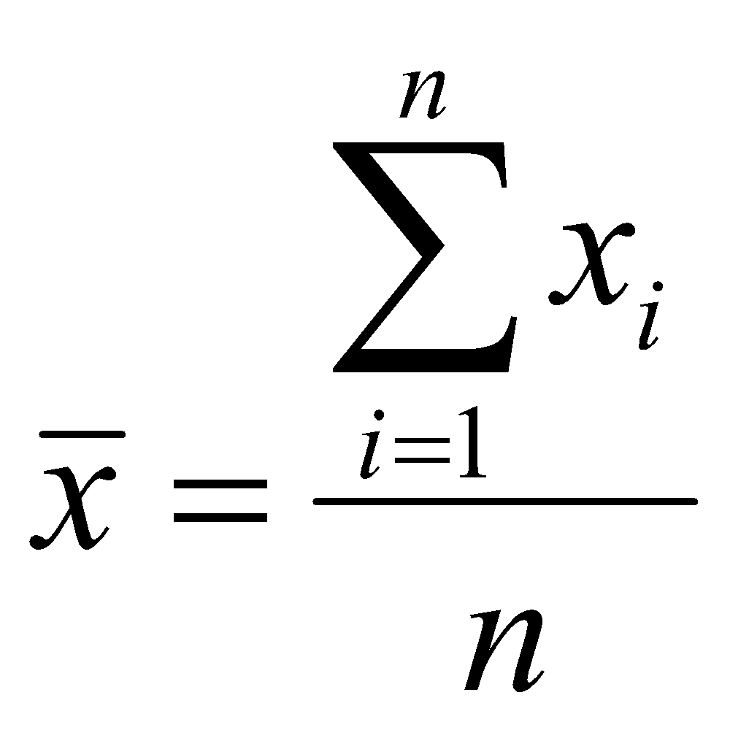
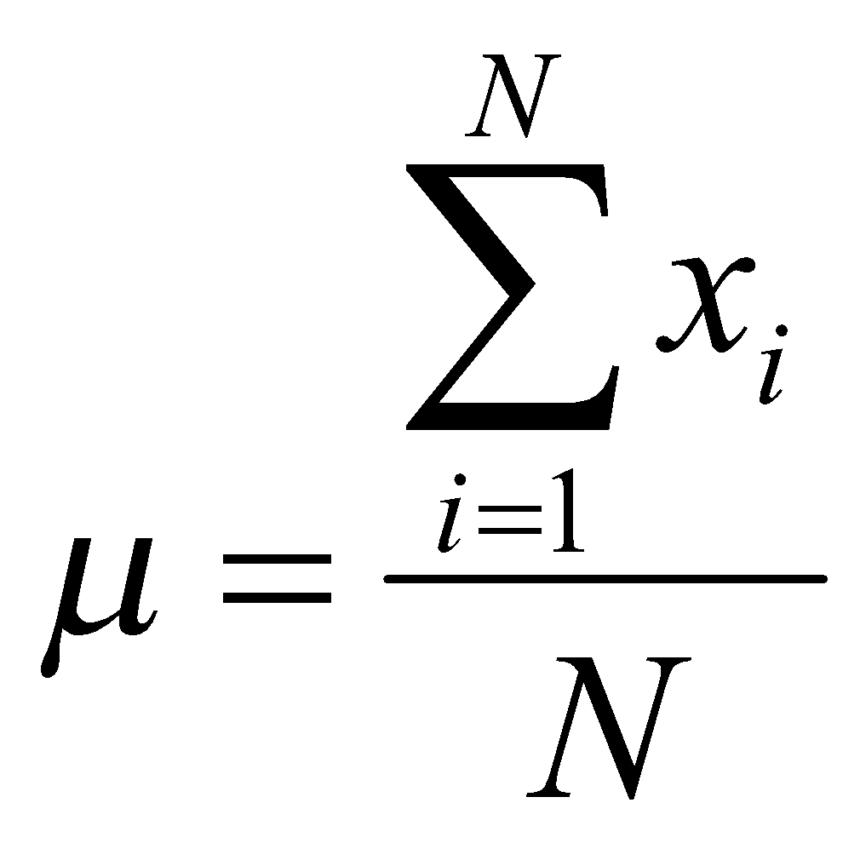
Measures of Central Tendency - Mean
Sample mean:
Population mean:

Slide 15
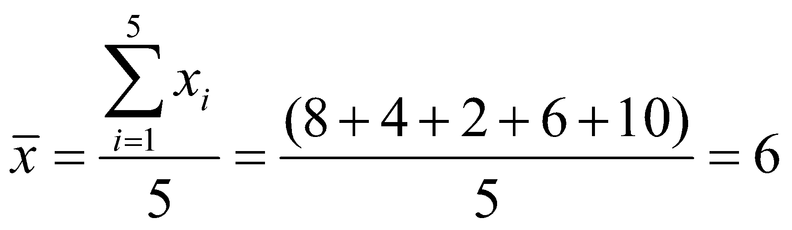
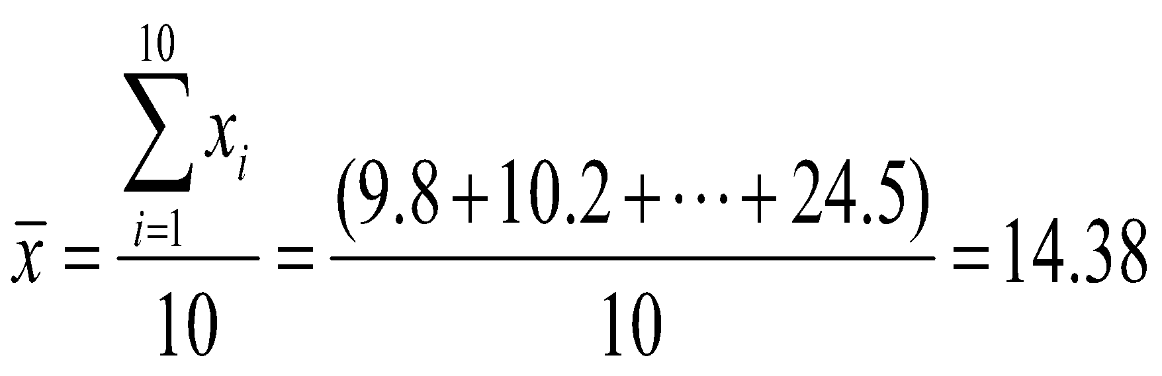
Measures of Central Tendency - Mean
Example I
Data: 8, 4, 2, 6, 10
Example II
Sample: 10 trees randomly selected from Battle Park
Diameter (inches):
9.8, 10.2, 10.1, 14.5, 17.5, 13.9, 20.0, 15.5, 7.8, 24.5

Slide 16
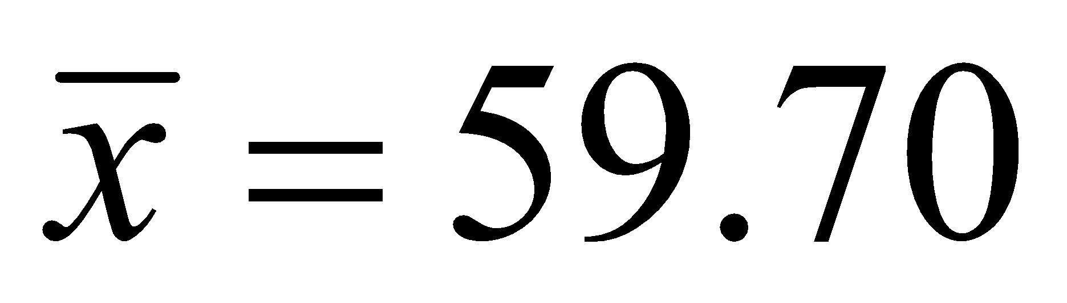
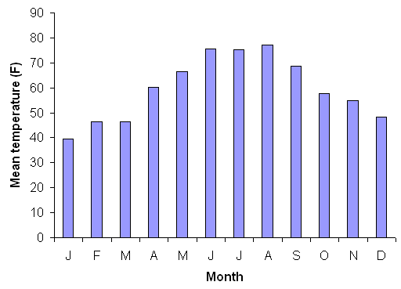
Measures of Central Tendency - Mean
Example III
Annual mean temperature (°F)
Monthly mean temperature (°F) at Chapel Hill, NC (2001).

Slide 17
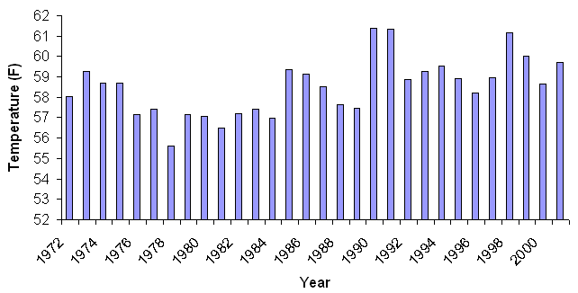
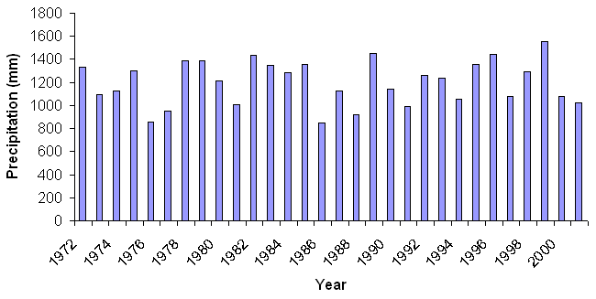
Mean annual precipitation (mm)
Example IV
Mean
1198.10 (mm)
Mean annual temperature ((°F)
Mean
58.51 (°F)
Chapel Hill, NC
(1972-2001)

Slide 18
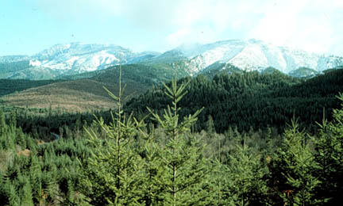
Measures of Central Tendency - Mean
Advantage
Sensitive to any change in the value of any observation
Disadvantage
Very sensitive to outliers
# | Tree Height (m) |  | # | Tree Height (m)
1 | 5.0 |  | 6 | 5.3
2 | 6.0 |  | 7 | 7.1
3 | 7.5 |  | 8 | 25.4
4 | 8.0 |  | 9 | 7.5
5 | 4.8 |  | 10 | 4.5
Mean = 6.19 m Mean = 8.10 m

Slide 19
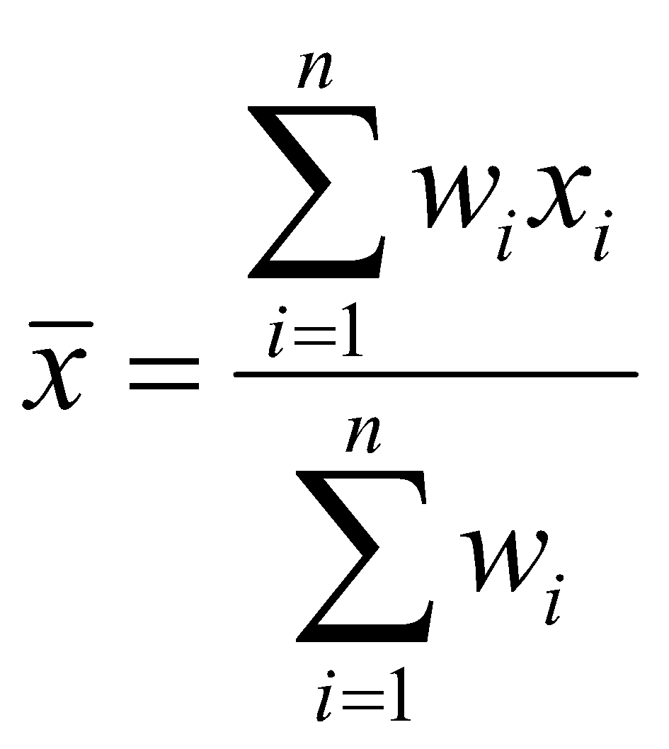
Weighted Mean
We can also calculate a weighted mean using some weighting factor:
e.g. What is the average income of all people in cities A, B, and C:
City Avg. Income Population
A $23,000 100,000
B $20,000 50,000
C $25,000 150,000
Here, population is the weighting factor and the average income is the variable of interest

Slide 20
Measures of Central Tendency – Median
Measures of Central Tendency – Median
Median – This is the value of a variable such that half of the observations are above and half are below this value i.e. this value divides the distribution into two groups of equal size
When the number of observations is odd, the median is simply equal to the middle value
When the number of observations is even, we take the median to be the average of the two values in the middle of the distribution

Slide 21
Measures of Central Tendency – Median
Example I
Data: 8, 4, 2, 6, 10 (mean: 6)
2, 4, 6, 8, 10
median: 6
Example II
Sample: 10 trees randomly selected from Battle Park
Diameter (inches):
9.8, 10.2, 10.1, 14.5, 17.5, 13.9, 20.0, 15.5, 7.8, 24.5
(mean: 14.38)
7.8, 9.8, 10.1, 10.2, 13.9, 14.5, 15.5, 17.5, 20.0, 24.5
median: (13.9 + 14.5) / 2 = 14.2

Slide 22
# | Tree Height (m) |  | # | Tree Height (m)
1 | 5.0 |  | 6 | 5.3
2 | 6.0 |  | 7 | 7.1
3 | 7.5 |  | 8 | 25.4
4 | 8.0 |  | 9 | 7.5
5 | 4.8 |  | 10 | 4.5
Source: http://www.forestlearn.org/forests/refor.htm
Mean = 6.19 m Mean = 8.10 m
# | Tree Height (m) |  | # | Tree Height (m)
1 | 4.5 |  | 6 | 7.1
2 | 4.8 |  | 7 | 7.5
3 | 5.0 |  | 8 | 7.5
4 | 5.3 |  | 9 | 8.0
5 | 6.0 |  | 10 | 25.4
median: (6.0 + 7.1) / 2 = 6.55
Advantage: the value is NOT affected by extreme values at the end of a distribution (which are potentially are outliers)

Slide 23
Measures of Central Tendency – Mode
Mode - This is the most frequently occurring value in the distribution
This is the only measure of central tendency that can be used with nominal data
The mode allows the distribution's peak to be located quickly

Slide 24
Mean = 6.19 m (without outlier)
Mean = 8.10 m
Source: http://www.forestlearn.org/forests/refor.htm
median: (6.0 + 7.1) /2 = 6.55
# | Tree Height (m) |  | # | Tree Height (m)
1 | 4.5 |  | 6 | 7.1
2 | 4.8 |  | 7 | 7.5
3 | 5.0 |  | 8 | 7.5
4 | 5.3 |  | 9 | 8.0
5 | 6.0 |  | 10 | 25.4
mode: 7.5

Slide 25
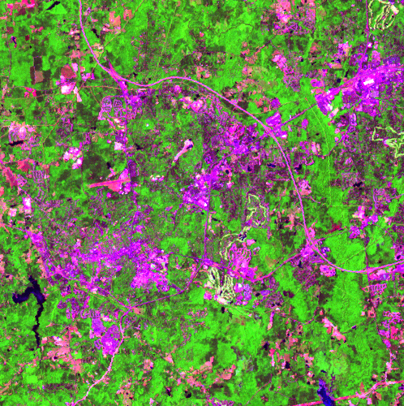
30 | 40 | 25 | 50 | 45
50 | 55 | 45 | 48 | 61
60 | 75 | 70 | 45 | 72
24 | 45 | 200 | 205 | 65
65 | 39 | 58 | 45 | 65
Landsat ETM+, Chapel Hill (2002-05-24)
(7-4-1 band combination)
24, 25, 30, 39, 40, 45, 45, 45, 45, 45, 48, 50, 50,
55, 58, 60, 61, 65, 65, 65, 70, 72, 75, 200, 205
mean: 63.28 median: 50 mode: 45
mean (without outliers): 51.17

Slide 26
Which one is better: mean, median, or mode?
Most often, the mean is selected by default
The mean's key advantage is that it is sensitive to any change in the value of any observation
The mean's disadvantage is that it is very sensitive to outliers
We really must consider the nature of the data, the distribution, and our goals to choose properly

Slide 27
Some Characteristics of Data
Not all data is the same. There are some limitations as to what can and cannot be done with a data set, depending on the characteristics of the data
Some key characteristics that must be considered are:
A. Continuous vs. Discrete
B. Grouped vs. Individual
C. Scale of Measurement

Slide 28
A. Continuous vs. Discrete Data
Continuous data can include any value (i.e., real numbers)
e.g., 1, 1.43, and 3.1415926 are all acceptable values.
Geographic examples: distance, tree height, amount of precipitation, etc
Discrete data only consists of discrete values, and the numbers in between those values are not defined (i.e., whole or integer numbers)
e.g., 1, 2, 3.
Geographic examples: # of vegetation types,

Slide 29
B. Grouped vs. Individual Data
The distinction between individual and grouped data is somewhat self-explanatory, but the issue pertains to the effects of grouping data
While a family income value is collected for each household (individual data), for the purpose of analysis it is transformed into a set of classes (e.g., <$10K, $10K-20K, > $20K)
e.g., elevation (1000m vs. < 500m, 500-1000m, 1000-2000m, > 2000m)

Slide 30
B. Grouped vs. Individual Data
In grouped data, the raw individual data is categorized into several classes, and then analyzed
The act of grouping the data, by taking the central value of each class, as well as the frequency of the class interval, and using those values to calculate a measure of central tendency has the potential to introduce a significant distortion
Grouping always reduces the amount of information contained in the data

Slide 31
C. Scales of Measurement
Data is the plural of a datum, which are generated by the recording of measurements
Measurements involves the categorization of an item (i.e., assigning an item to a set of types) when the measure is qualitative
or makes use of a number to give something a quantitative measurement

Slide 32
Type of Data
The data used in statistical analyses can divided into four types:
1. The Nominal Scale
2. The Ordinal Scale
3. The interval Scale
4. The Ratio Scale
As we progress through these scales, the types of data they describe have increasing information content

Slide 33
The Nominal Scale
Nominal scale data are data that can simply be broken down into categories, i.e., having to do with names or types
Dichotomous or binary nominal data has just two types, e.g., yes/no, female/male, is/is not, hot/cold, etc
Multichotomous data has more than two types, e.g., vegetation types, soil types, counties, eye color, etc
Not a scale in the sense that categories cannot be ranked or ordered (no greater/less than)

Slide 34
The Ordinal Scale
Ordinal scale data can be categorized AND can be placed in an order, i.e., categories that can be assigned a relative importance and can be ranked such that numerical category values have
star-system restaurant rankings
5 stars > 4 stars, 4 stars > 3 stars, 5 stars > 2 stars
BUT ordinal data still are not scalar in the sense that differences between categories do not have a quantitative meaning
i.e., a 5 star restaurant is not superior to a 4 star restaurant by the same amount as a 4 star restaurant is than a 3 star restaurant

Slide 35
The Interval Scale
Interval scale data take the notion of ranking items in order one step further, since the distance between adjacent points on the scale are equal
For instance, the Fahrenheit scale is an interval scale, since each degree is equal but there is no absolute zero point.
This means that although we can add and subtract degrees (100° is 10° warmer than 90°), we cannot multiply values or create ratios (100° is not twice as warm as 50°)
Notes:
Interval scale is something that can measure on an interval scale. The distance btw the adjacent point are equal and can go below zero. One example of interval scale is temperature. Temperature can go below negative.

Slide 36
The Ratio Scale
Similar to the interval scale, but with the addition of having a meaningful zero value, which allows us to compare values using multiplication and division operations, e.g., precipitation, weights, heights, etc
e.g., rain – We can say that 2 inches of rain is twice as much rain as 1 inch of rain because this is a ratio scale measurement
e.g., age – a 100-year old person is indeed twice as old as a 50-year old one

Slide 37
Which one is better: mean, median, or mode?
The mean is valid only for interval data or ratio data.
The median can be determined for ordinal data as well as interval and ratio data.
The mode can be used with nominal, ordinal, interval, and ratio data
Mode is the only measure of central tendency that can be used with nominal data

Slide 38
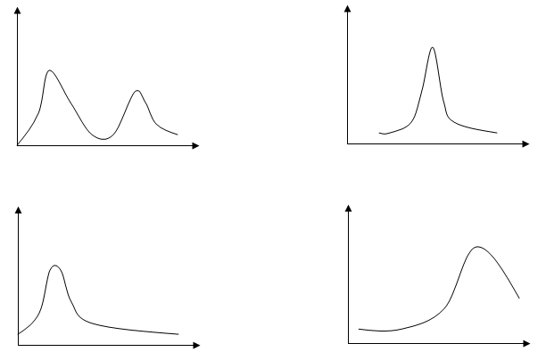
Which one is better: mean, median, or mode?
It also depends on the nature of the distribution

Slide 39
Which one is better: mean, median, or mode?
It also depends on your goals
Consider a company that has nine employees with salaries of 35,000 a year, and their supervisor makes 150,000 a year.
If you want to describe the typical salary in the company, which statistics will you use?
I will use mode or median (35,000), because it tells what salary most people get

Slide 40
Which one is better: mean, median, or mode?
It also depends on your goals
Consider a company that has nine employees with salaries of 35,000 a year, and their supervisor makes 150,000 a year
What if you are a recruiting officer for the company that wants to make a good impression on a prospective employee?
The mean is (35,000*9 + 150,000)/10 = 46,500 I would probably say: "The average salary in our company is 46,500" using mean

Slide 41
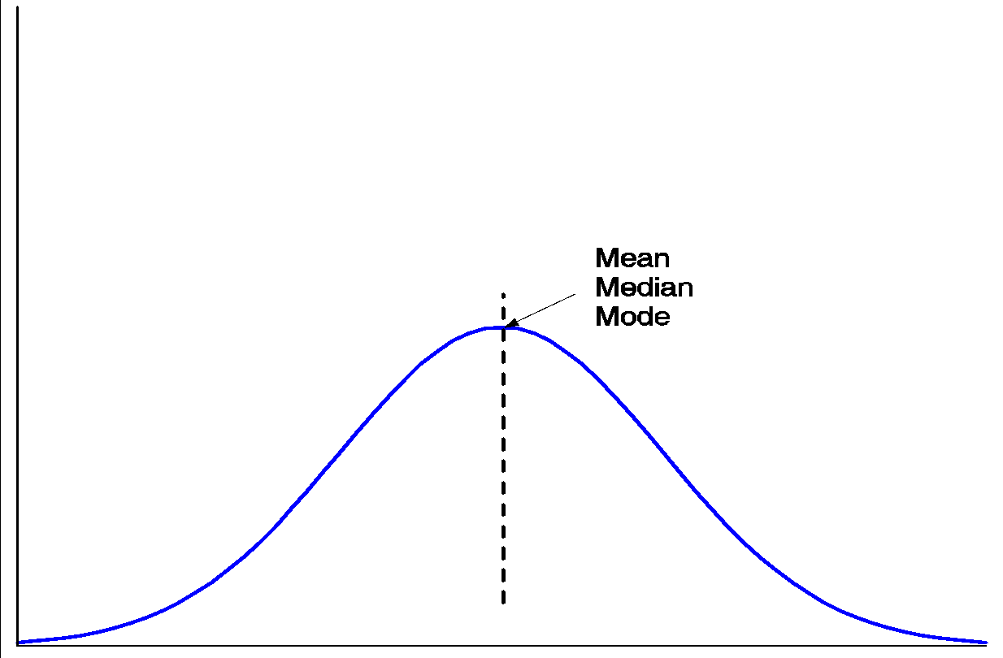
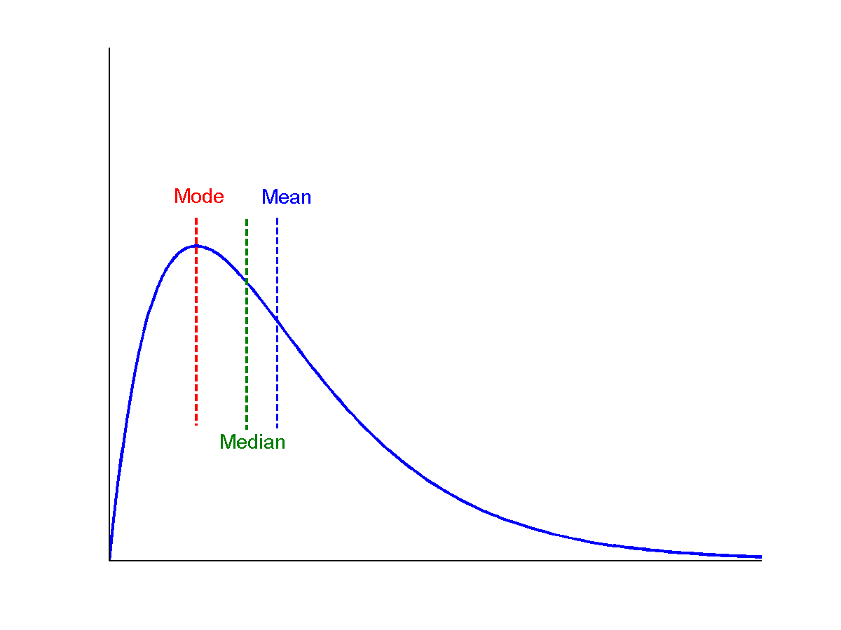
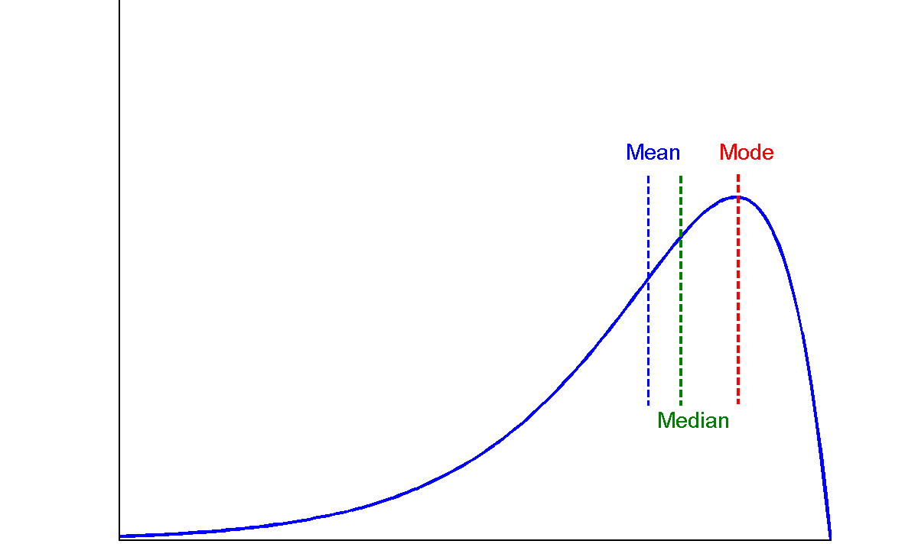
Symmetric vs. Skewed Data
Median, mean and mode of symmetric, positively and negatively skewed data

Slide 42
Outline
Why preprocess the data?
Descriptive data summarization
Data cleaning
Data integration and transformation
Data reduction
Discretization and concept hierarchy generation
Summary

Slide 43
Data Cleaning
Data Cleaning
Importance
“Data cleaning is one of the three biggest problems in data warehousing”—Ralph Kimball
“Data cleaning is the number one problem in data warehousing”—DCI survey
Data cleaning tasks
Fill in missing values
Identify outliers and smooth out noisy data
Correct inconsistent data
Resolve redundancy caused by data integration

Slide 44
Data Cleaning
How to handle missing data
Ignore the tuple: usually done when class label is missing (assuming the tasks in classification—not effective when the percentage of missing values per attribute varies considerably.
Fill in the missing value manually: tedious + infeasible?
Fill in it automatically with
a global constant : e.g., “unknown”, a new class?!
the attribute mean
Imputation: fill in the missing value using the feature mean or the most probable value.

Slide 45
Data Cleaning
Imputing the missing data
Delete missing observations
Can lead to serious biases.
If missing data is relatively small, may be okay.
Cold-deck imputation
Hot-deck imputation
Distribution-based imputation
Statistical imputation
Predictive imputation

Slide 46
Data Cleaning
Cold-deck imputation
Fill in the data using means or other analysis of the variable to fill in the value.
Measure of central tendency (mean, median, mode)

Slide 47
Data Cleaning
Hot - deck imputation
Identify the most similar case to the case with a missing value and substitute the most similar case’s value for the missing case’s value.
Advantages: simplicity, maintains level of measurement, complete data at the end.
Disadvantage: can identify more than one similar case and randomly select or use average.

Slide 48
Data Cleaning
Distributed-based imputation
Assign value based on the probability distribution of the non-missing data.
Tries to capture the “observed” empirical distribution of data.

Slide 49
Data Cleaning
Statistical Imputation
Build a regressor to classify the input value
Consider the “missing” value as the “output” and the rest of the features as input
Imputes the value based on other features

Slide 50
Data Cleaning
Predictive Imputation
Let a classifier model the underpinnings of the missingness mechanism.

Slide 51
Data Cleaning
Noisy data
Noise: random error or variance in a measured variable
Incorrect attribute values may due to
faulty data collection instruments
data entry problems
data transmission problems
technology limitation
inconsistency in naming convention
Other data problems which requires data cleaning
duplicate records
incomplete data
inconsistent data

Slide 52
Data Cleaning
How to Handle Noisy Data?
Binning
first sort data and partition into (equal-frequency) bins
then one can smooth by bin means, smooth by bin median, smooth by bin boundaries, etc.
Regression
smooth by fitting the data into regression functions
Clustering
detect and remove outliers
Combined computer and human inspection
detect suspicious values and check by human (e.g., deal with possible outliers)

Slide 53
Data Cleaning
Simple Discretization Methods: Binning
Equal-width (distance) partitioning
Divides the range into N intervals of equal size: uniform grid
if A and B are the lowest and highest values of the attribute, the width of intervals will be: W = (B –A)/N.
The most straightforward, but outliers may dominate presentation
Skewed data is not handled well
Equal-depth (frequency) partitioning
Divides the range into N intervals, each containing approximately same number of samples
Good data scaling
Managing categorical attributes can be tricky

Slide 54
Data Cleaning
Binning Methods for Data Smoothing
Sorted data for price (in dollars): 4, 8, 9, 15, 21, 21, 24, 25, 26, 28, 29, 34
* Partition into equal-frequency (equi-depth) bins:
- Bin 1: 4, 8, 9, 15
- Bin 2: 21, 21, 24, 25
- Bin 3: 26, 28, 29, 34
* Smoothing by bin means:
- Bin 1: 9, 9, 9, 9
- Bin 2: 23, 23, 23, 23
- Bin 3: 29, 29, 29, 29
* Smoothing by bin boundaries:
- Bin 1: 4, 4, 15, 15
- Bin 2: 21, 21, 25, 25
- Bin 3: 26, 26, 34, 34

Slide 55
Data Cleaning
Handle Missing Values
Remove the attribute
Create a new attribute to handle the missing values
Remove the data (if it is not too many)
Imputation of Missing Values:- Use commonly used values or average the value
Use supervised learning to predict the missing values and use those values

Slide 56
Related Videos / Reference
Data Preprocessing Steps for Machine Learning & Data analytics (youtube video)
https://www.youtube.com/watch?v=NBm4etNMT5k

